Slide 1
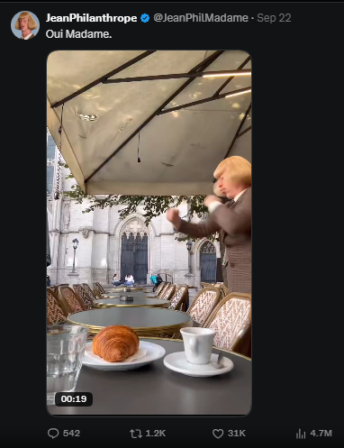
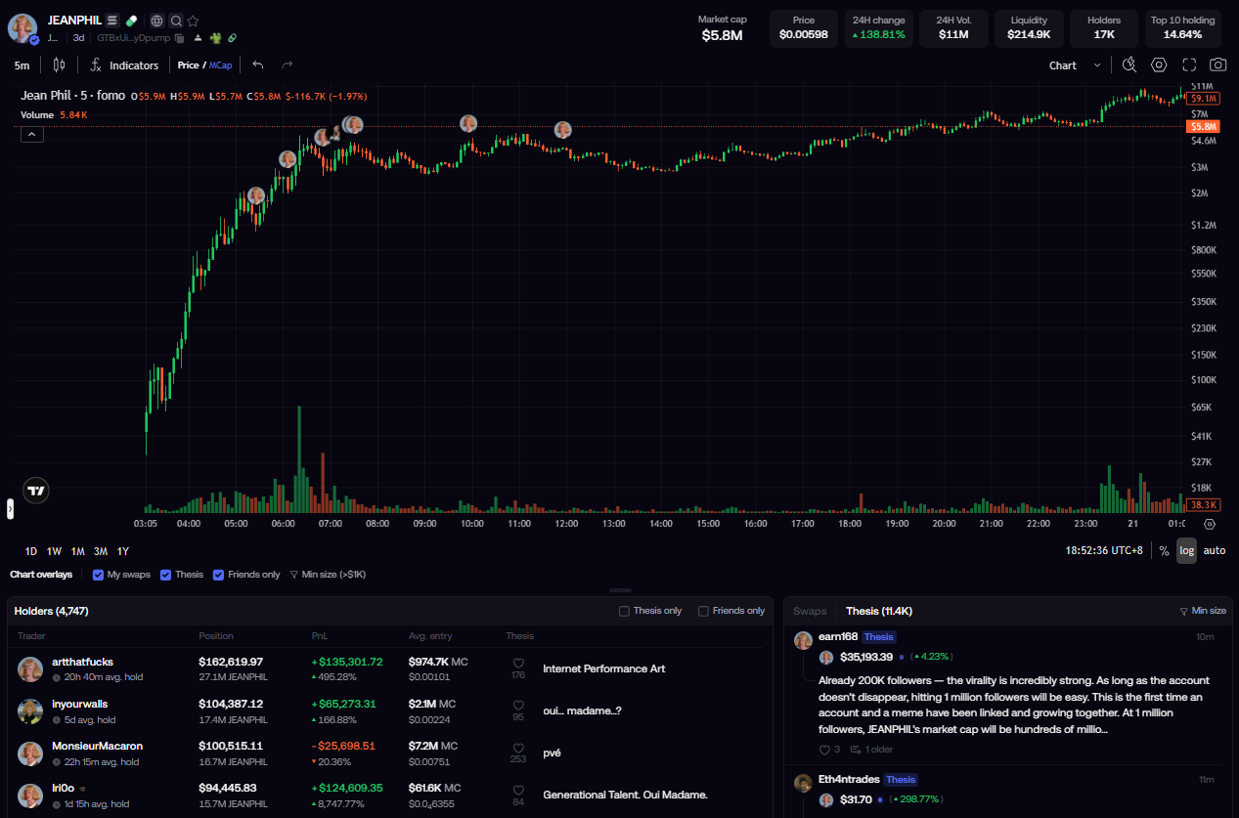
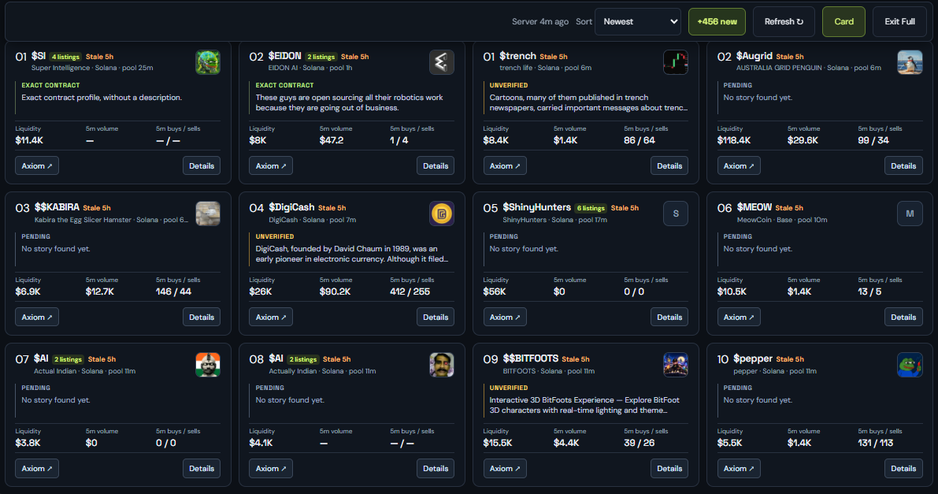
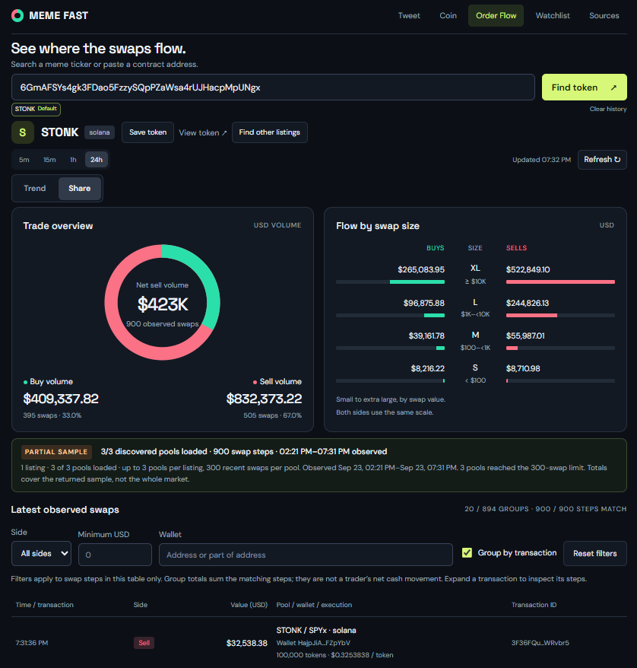
PRODUCT OWNER PERSPECTIVE
We are in a attention economy – and it is monetarized either into a physical products, arts, NFTS or Crypto.
In Tweeter, there is funny hair guy doing fist fight in his shorts vid, it got viral.
And the attention monetized into coin market value.
FOR HIGH-SPEED SOCIAL TRADERS HUNTING FOR ATTENTION OPPORTUNITY
01
02
03
MEME-FAST
The Tweet(s)
The Economics
The Utility
6.6 M
30k
MEME-FAST • Track where attention turns into money.
Notes:
[Sources]
- User-provided the pitch.txt
- User clarification: Trade-Lite is a lightweight, customizable personal app beyond trading-script customization.
[/Sources]

Slide 2
SOLUTION ARCHITECTURE
Follow attention until it becomes market activity.
MEME-FAST connects the narrative, the token and the actual flow.
SYSTEM FLOW
01
02
03
04
ATTENTION
TOKEN
PARTICIPATION
FOCUS
News • stories • social leads
Fresh Solana / Base pools
Liquidity • volume • buys / sells
Order flow • watchlist
What is getting noticed?
Where did the attention land?
Is money actually moving?
What deserves a closer look?
ATTENTION → TOKEN → PARTICIPATION → FOCUS
5-minute scan • Solana + Base
Product concept, requirements and build: Benedict Yong
AI-assisted development with Claude and Codex
Notes:
[Sources]
- User-provided the pitch.txt
- User-provided Trade-Lite.pptx
- User clarification: popular Bitunix USDT tickers provide real-time M1 data; Telegram notification is available but inactive.
[/Sources]

Slide 3
SOLUTION ARCHITECTURE
The wiring under MEME-FAST
Public signals on the left. Trader context on the right.
INPUTS
TRADER VIEW
PUBLIC NEWS
Coin telegraph
MEME-FAST ENGINE
TWEET
What is getting attention?
headline evidence
DISCOVER
GROUP
COIN
Where is participation?
MARKET
GeckoTerminal
pools • liquidity • activity
ORDER FLOW
Where are swaps flowing?
MATCH
RANK
TOKEN LOOKUP
DEX Screener
discovery support
WATCHLIST
What stays on radar?
Narrative + contract + market context
Connected today
Public news • Solana / Base pools • observed swap flow
X watchlist: planned, not connected
AI-assisted build: Claude + Codex

Slide 4
TECH STACK
The stack behind MEME-FAST
Public feeds + market APIs + lightweight browser logic, deployed as one fast research tool.
DATA SOURCES
INGEST + LOGIC
FRONT END
DEPLOY + BUILD
External signals
Turn raw feeds into context
Fast browser workspace
Ship and iterate quickly
NEWS
Decrypt RSS
Cointelegraph RSS
RSS2JSON
news feed bridge
HTML5
CSS
JS
MODAL
web endpoint
server execution
REST / JSON
market-data fetch
JavaScript ES modules
MARKET
GeckoTerminal
Solana + Base
Browser-local state / history
LOCAL
no login
local config
5 MIN
pool scan / refresh
TRADER VIEWS
LOOKUP
DEX Screener
contract discovery
COIN
NARRATIVE
AI-ASSISTED DELIVERY
APP LOGIC
CLAUDE
CODEX
• Headline clustering
ORDER FLOW
WATCHLIST
PUBLIC + READ-ONLY DATA
• Exact CA matching
Product definition → prompt / requirements → build → test on live data
• Pool filtering + ranking
60s visible-page order-flow refresh
• Swap aggregation + cache
REQUEST PATH
SIGNAL → FETCH → FILTER / MATCH → MARKET CONTEXT → TRADER VIEW
MEME-FAST • V2.1
Connected today: public news • Solana / Base pools • observed swaps
X watchlist is planned; live X collection is not connected

Slide 5
WORKING PRODUCT
MEME-FAST: from attention to market context
COIN SCANNER
ORDER FLOW
bytx24--meme-fast-web.modal.run

Slide 6
